Slide 1
Diego Alejandro Mesa Vasquez
Ana Carolina Bermudez Paredes
Software análisis and development
Presentation of my family

Slide 2
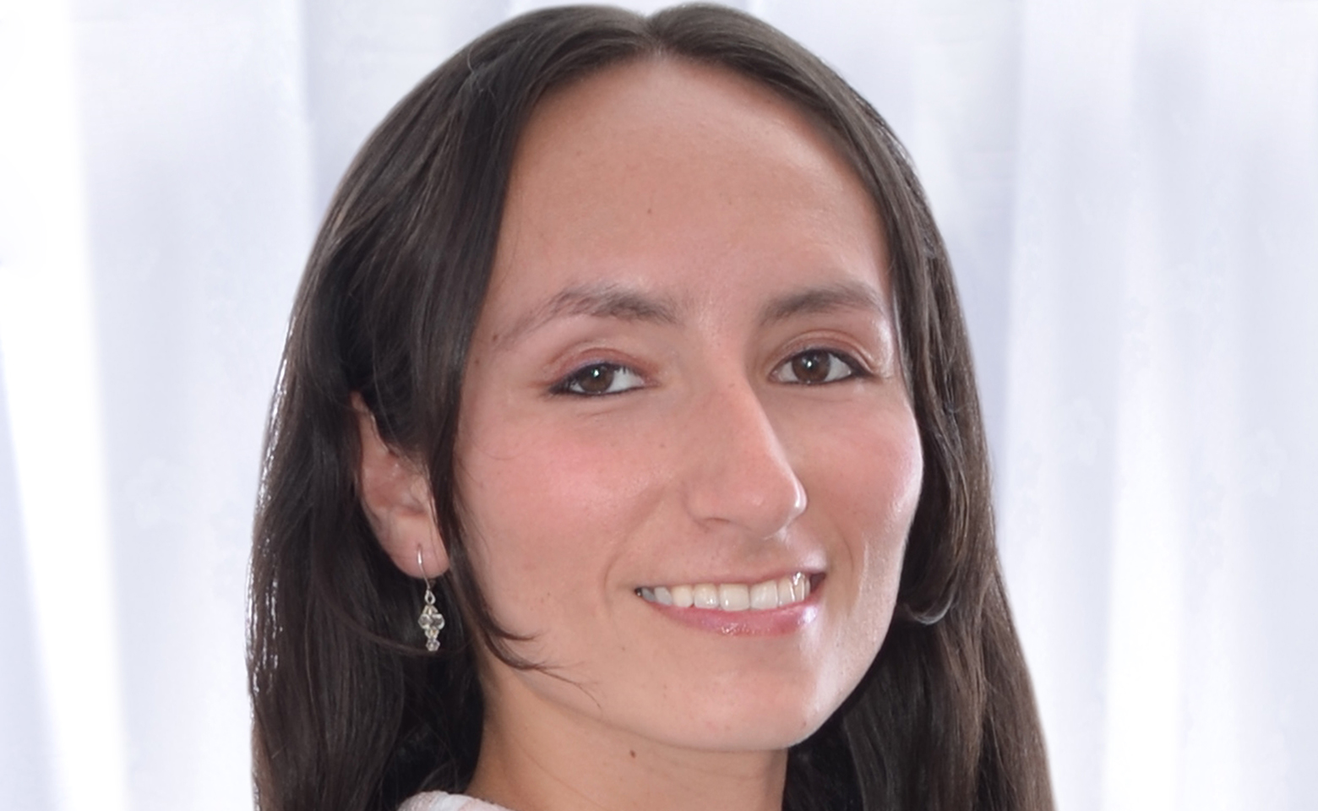
Aide castaño
She is a photograper with ten years of experience.
We have been living together for fifteen years and married for five years.
I think she is a great woman
She is my wife
¡i love you!

Slide 3
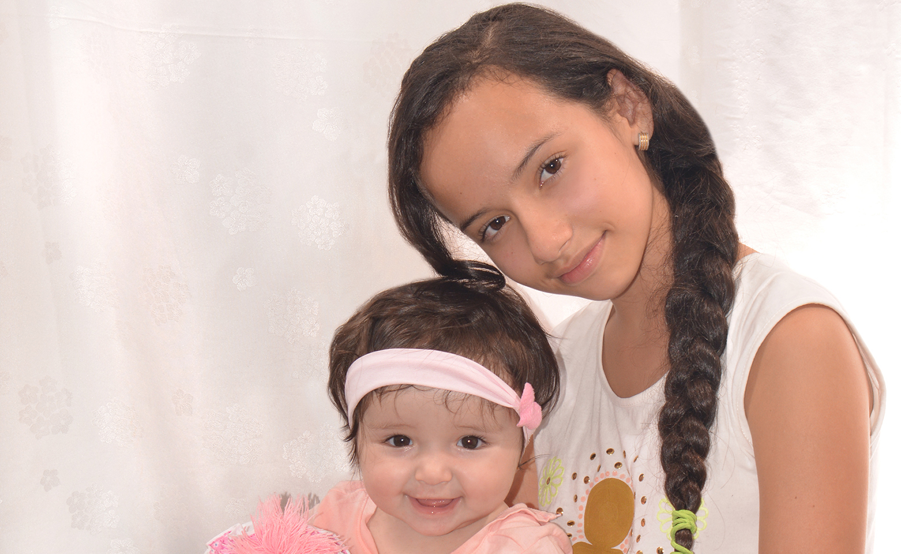
Milena and juliana
They are my daugthers.
One is fourteen years old and the other is four years old.
They are both very smiley and love to watch cartoons
My princesses

Slide 4
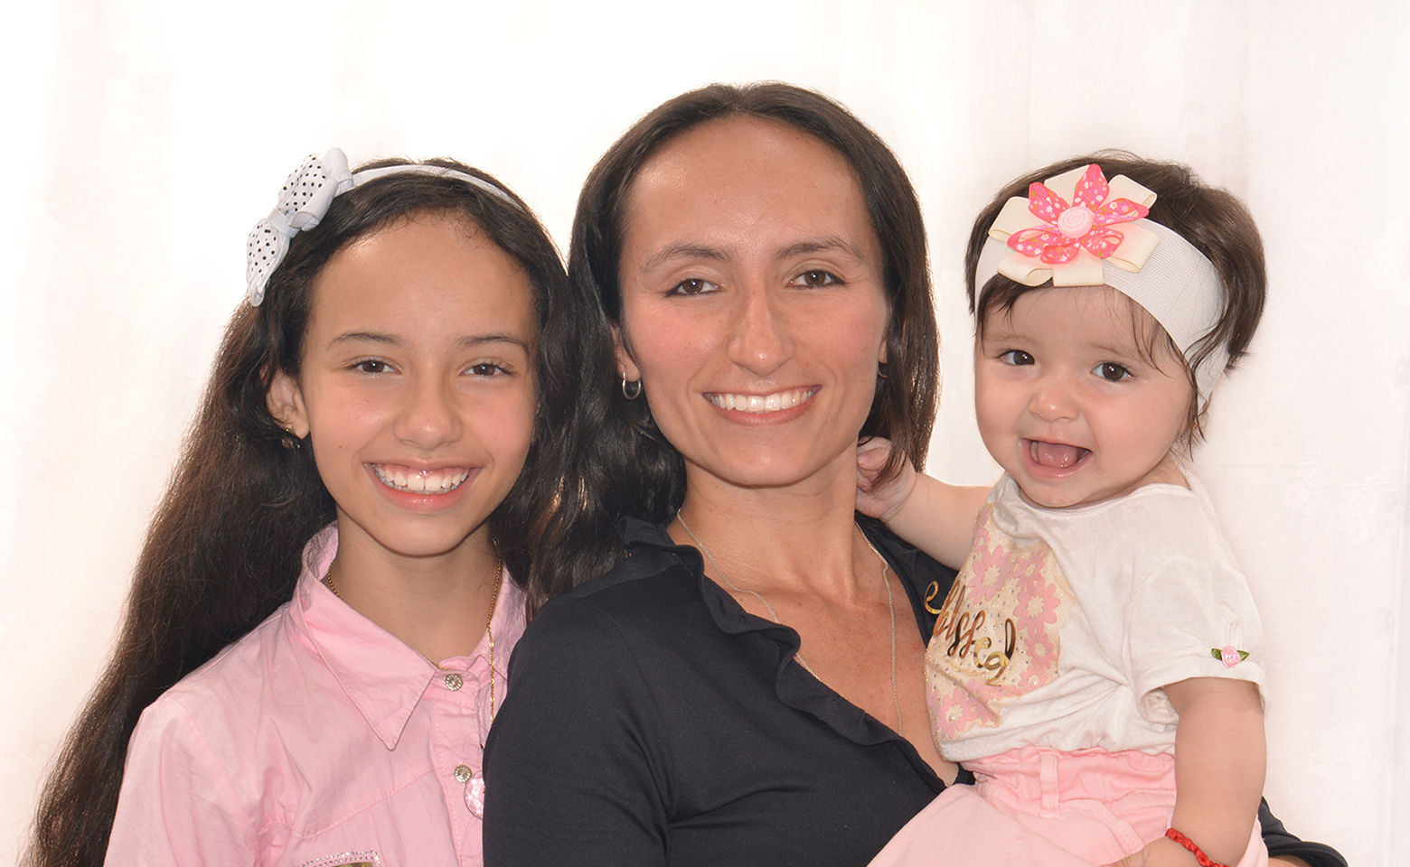
The most valuable thing i have
.
My family is of Colombian nationality.
We live in the city of Medellin.
We work constantly to get ahead and we firmly believe in the importance of education.
This is my family

Slide 5
Thank you very much for your time!!!
A hug for everyone !!!
Bye!!

